Slide 1
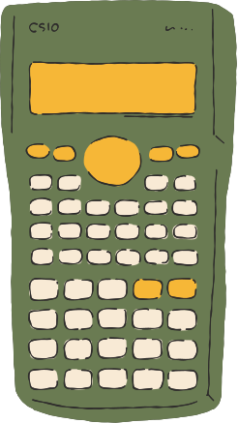
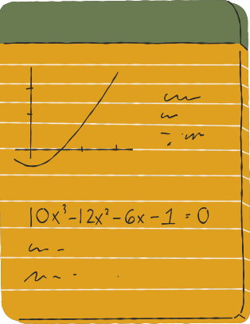








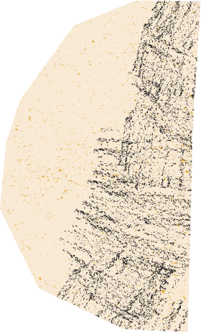

Next Hikes IT Solutions
Scientific Calculator
*Presenter* Brijesh Patel

Slide 2




Developed a Graphical Scientific Calculator using Python and Tkinter.
01.
Project Vision, Functionalities & Uniqueness
Includes basic (add, subtract, multiply, divide) and scientific (sin, cos, tan, log, etc.) operations.
Memory functions added: MC, MR, M+, M-
02.
Keyboard support for faster input.
Styled UI with color themes.
-Smart percentage logic.
03.

Slide 3





Libraries and GUI Used
Tkinter :- GUI creation and window management.
Math :- Used for scientific functions like sqrt, log10, sin, cos, etc.

Slide 4








Handling complex user input
Used expression parsing and safe eval logic
Designing clean GUI with many buttons
Challenges
&
Solutions
Used grid layout and color coding
Implementing memory functionality
Managed memory state logically and clearly

Slide 5

-: References :-
Python Tkinter Documentation :-
docs.python.org/3/library/tkinter.html
Python Math Module :-
docs.python.org/3/library/math.html
Stack Overflow and GitHub for syntax guidance and UI inspiration

Slide 6
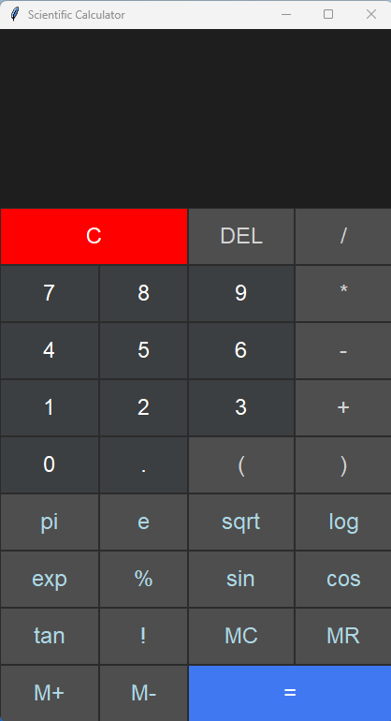


Slide 7



THANK YOU!
www.reallygreatsite.com

